Slide 1

TopPLate
Hirendira Caraveo Aragon

Slide 2
About
Finding new places to eat has never been easier!
Join on your own or together and pick where you want to eat.
Pick your screenname, create a group, swipe on places to eat, and go enjoy your meal!

Slide 3
Audience
Students
Newly weds
Population 16 to 35

Slide 4
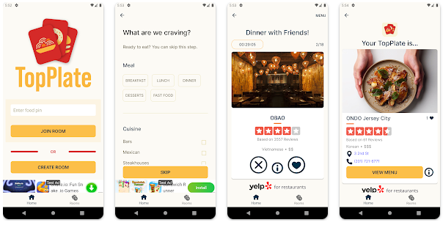
App framework

Slide 5

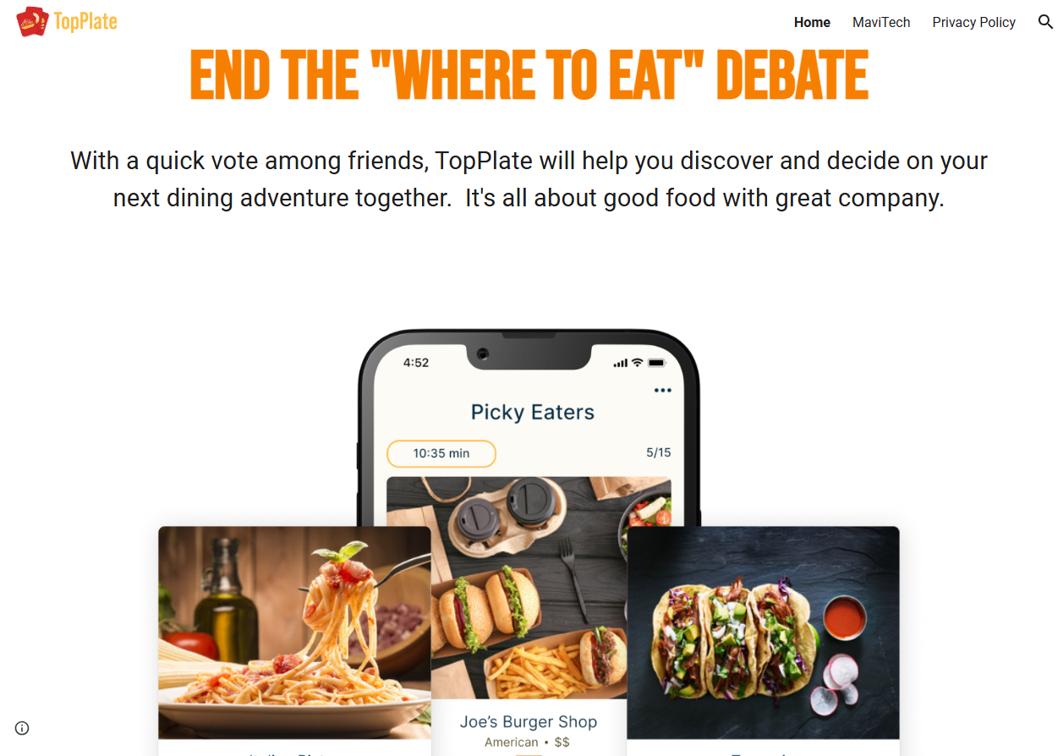
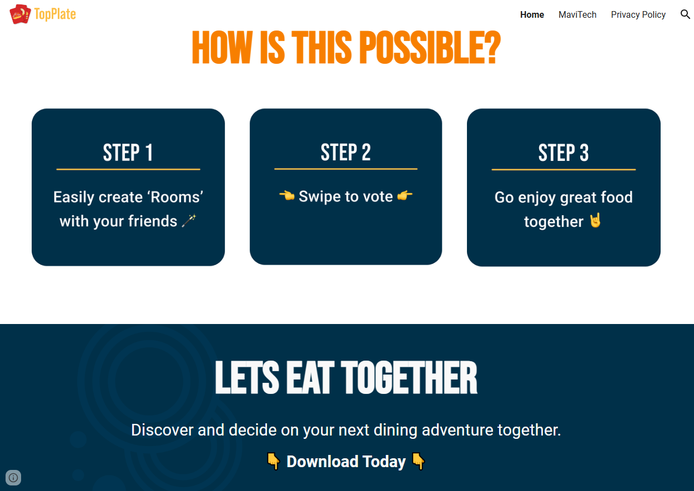
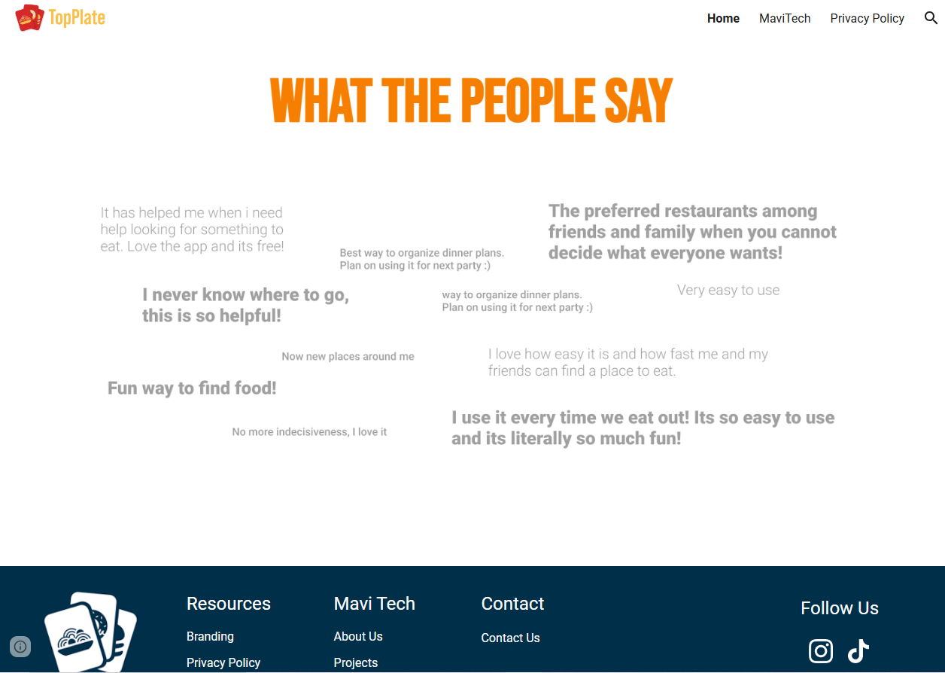
Website
https://www.techmavi.com/

Slide 6
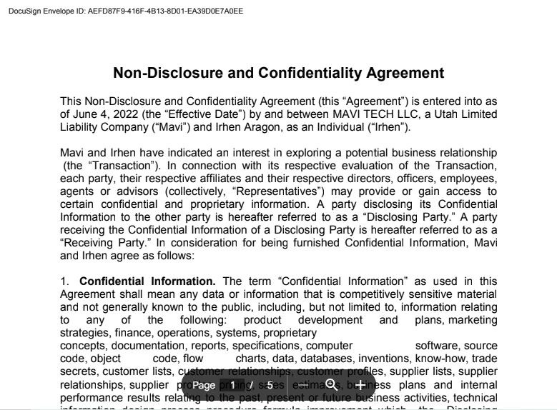
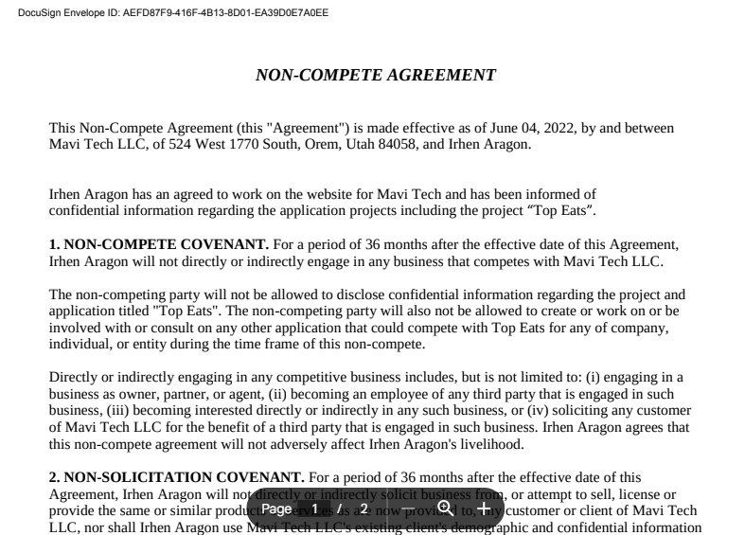
Contracts

Slide 7
Example of code that I used
<picture>
<source srcset="img1.jpg" media="(max-width: 600px)">
<source srcset="img_2.jpg" media="(max-width: 1500px)">
<source srcset=“f.jpg">
<img src="img_smal.jpg" alt="F">
</picture>
<style>
.left, .right {
float: left;
width: 20%; /* The width is 20%, by default */
}
.main {
float: left;
width: 60%; /* The width is 60%, by default */
}
/* Use a media query to add a breakpoint at 800px: */
@media screen and (max-width: 800px) {
.left, .main, .right {
width: 100%; /* The width is 100%, when the viewport is 800px or smaller */
}
}
</style>

